Slide 1
ASC
input
firing
voltage

Slide 2
decay
W_{lat}
a_{j},r_{j},k_{j}
update
W
ASC
decay
Input
SYN
firing
reset
R_{m},V_{reset}
update
V_{th}
k_{m},R_{m}
Voltage
update

Slide 3
lateral feedback
exponential decay
I_{j}(t)
voltage reset
I_{syn}(t)
V(t)
s(t)
exponential decay

Slide 4
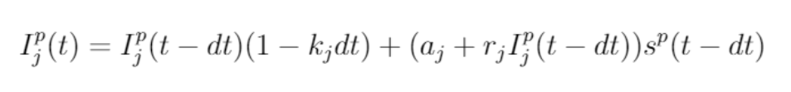

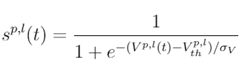
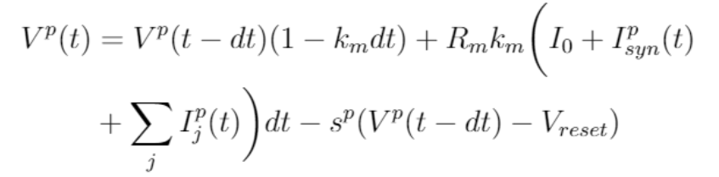
W_{lat}
k_{j}
I_{j}(t)
a_{j},r_{j}
V_{reset}
W_{in}
I_{syn}(t)
R_{m},k_{m}
V(t)
V_{th}
s(t)
k_{m}

Slide 5
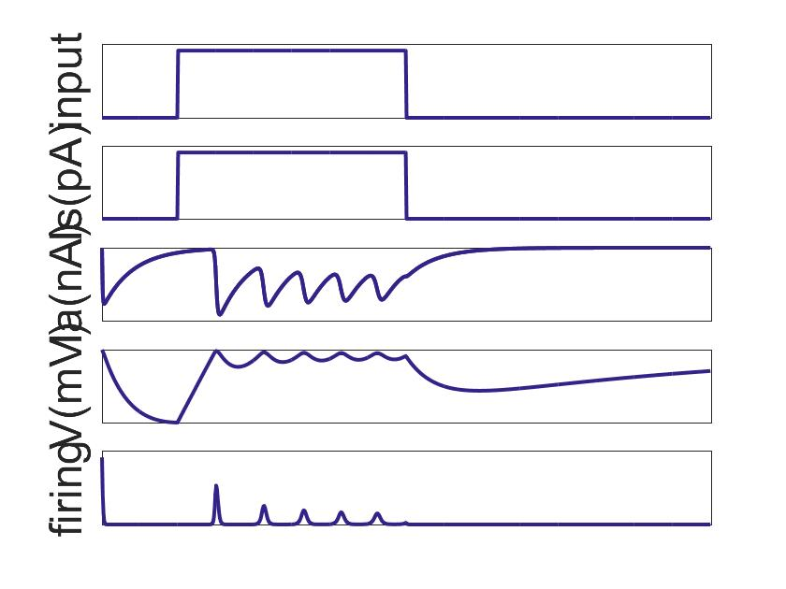
recurrent connection
current
decay
I_{j}(t)
after-spike current
voltage reset
I_{syn}(t)
synaptic current
V(t)
voltage
s(t)
firing rate
input
output
current integration
membrane decay

Slide 6
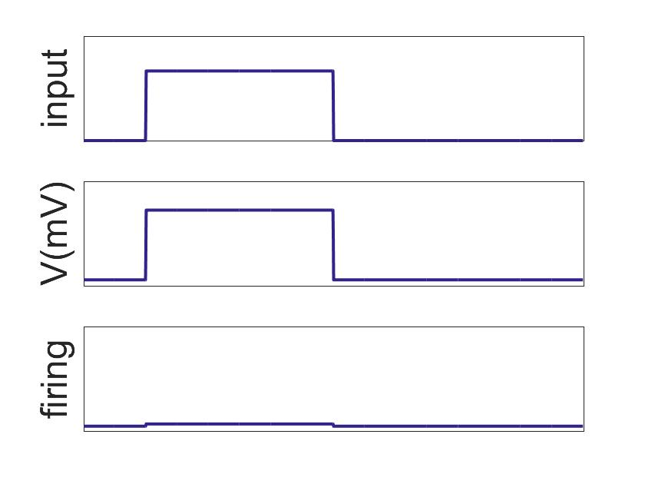
recurrent connection
r(t)
hidden state
s(t)
output
input
nonlinearity
output

Slide 7
W_{lat}
R_{m},
V_{reset}
a_{j},r_{j}
W
k_{m},R
V_{th}
Input
SYN
Voltage
ASC
firing
k_{m}
k_{j}

